Slide 1
Front End Engineering-I Project
Team Details:
MEMBERS OF OUR TEAM:-
HEAD:-Deeya Julka ( Designing, Code ,Recipe search,Idea)
Beant Kaur ( PPT Writing work, Designing, Ideas, Coding)
Arshpreet Kaur (Idea, Code, Report work, Design Layout)
Faculty coordinator:- Dr. Righa Tandon
Chitkara University Institute of Engineering and Technology,
Chitkara University, Punjab

Slide 2
Table of Content
INTRODUCTION
PROBLEM STATEMENT
TECHNICAL DETAILS
KEY FEATURES
PROJECT HIGHLIGHTS
BONUS FEATURES
CONCLUSION
REFERENCE/LINKS USED

Slide 3
Introduction
PROJECT:-RECIPE FINDER
TITLE:-DAINTY DELIGHTS
TEAM MEMBERS:-
ARSHPREET KAUR(2410992687)
BEANT KAUR(2410992695)
DEEYA JULKA(24100992708)
WHAT IS PURPOSE OF OUR SITE DAINTY DELIGHTS?
A web application designed to help users discover bakery recipes based on ingredients, skill level, and dietary preferences.
Purpose [1]
Simplify the process of finding and baking the perfect recipes, whether it’s bread, cakes, cookies, or pastries.
Cater to baking enthusiasts and professionals by offering specialized baking recipes and tips.

Slide 4
Problem Statement
Problem
Home bakers often face challenges such as:
1.Inability to find recipes that utilize specific ingredients they have on hand.
2.Difficulty in filtering recipes based on dietary restrictions such as gluten-free, vegan, etc.
3.Overwhelming choices leading to confusion and decision fatigue.The goal of Dainty Delights' is to address these challenges effectively.
Solution
A specialized bakery recipe finder that offers a wide range of bakery recipes based on the user’s available ingredients, skill level, and dietary needs.

Slide 5
Technical Details
FRONT END:-
HTML[2]
CSS
JAVASCRIPT(FOR FUTURE PROGRESS)
API :-
Any public recipe API with a focus on bakery –related recipes.
STATE MANAGEMENT:-
For managing recipe and user data.
DATA HANDLING :-
Filtering recipes for bakery–related items like bread, cakes, cookies, and pasteries.

Slide 6
Key Features
Ingredient- Based Search:-
Users can input bakery-specific ingredients (flour, sugar, yeast, etc.) to find matching recipes.
Skill Level Filter:-
Filter recipes by difficulty: beginner, intermediate, advanced.
Dietary Preferences:
Options to filter by gluten-free, sugar-free, vegan, or low-carb bakery recipes.
Recipe Categories:
Recipes sorted into categories like cakes, cookies, breads, pastries etc.

Slide 7
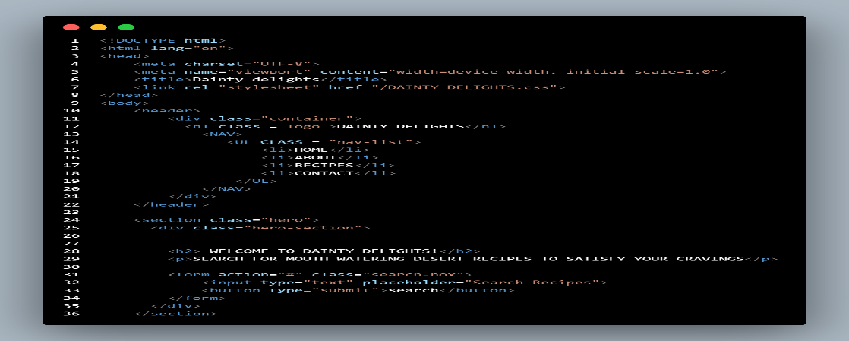
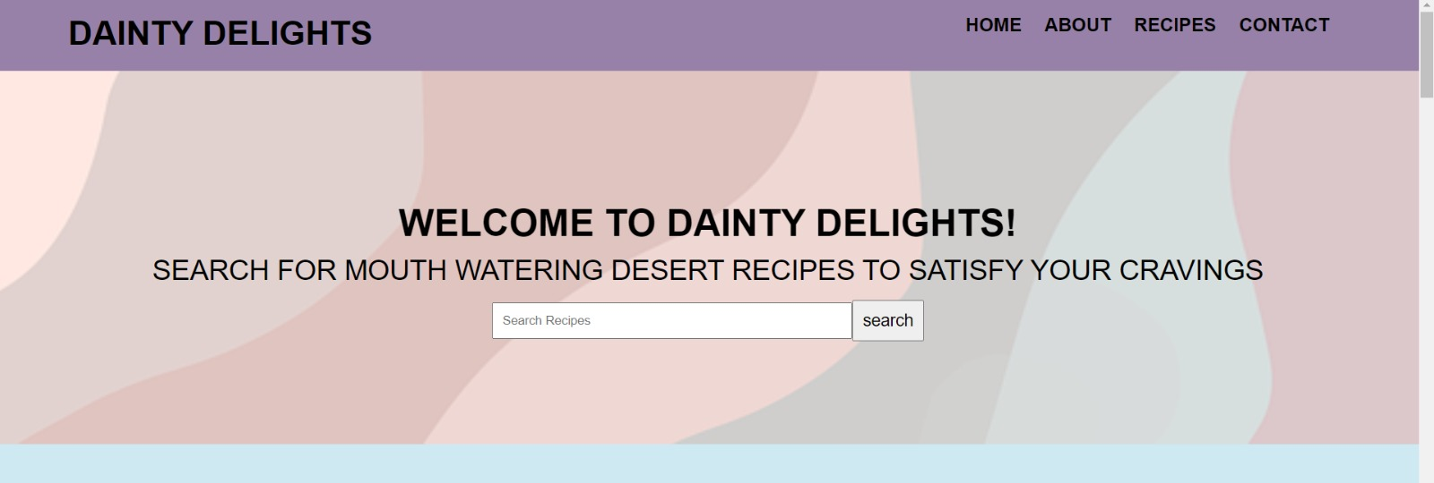
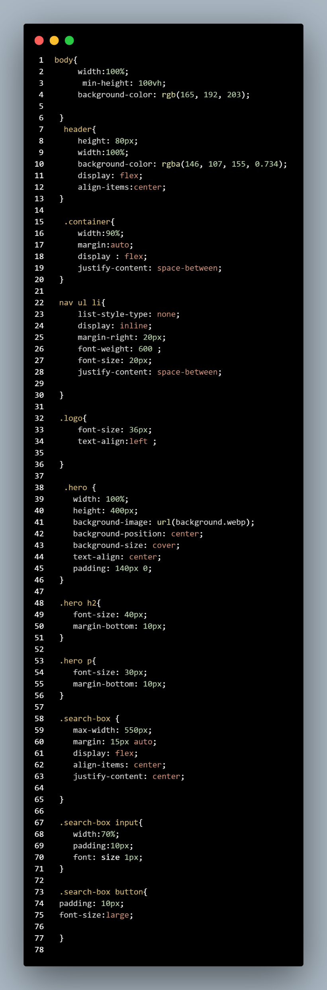
Project Highlights
1.First Section:-
DAINTY DELIGHTS HOME PAGE:-This is the welcome page, displaying the site name, home, about, and contact options, along with a search bar.
(HTML)
(HTML)
(OUTPUT)
(CSS)

Slide 8
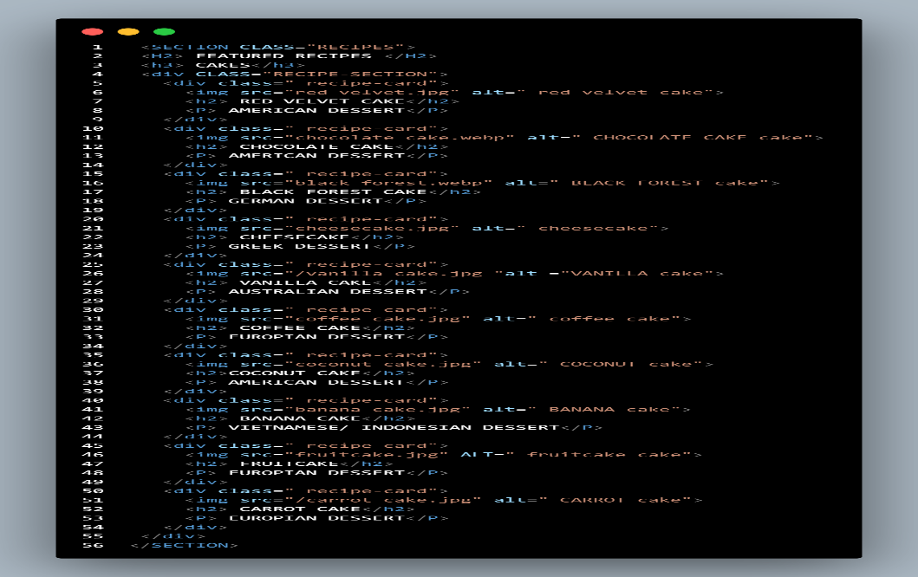
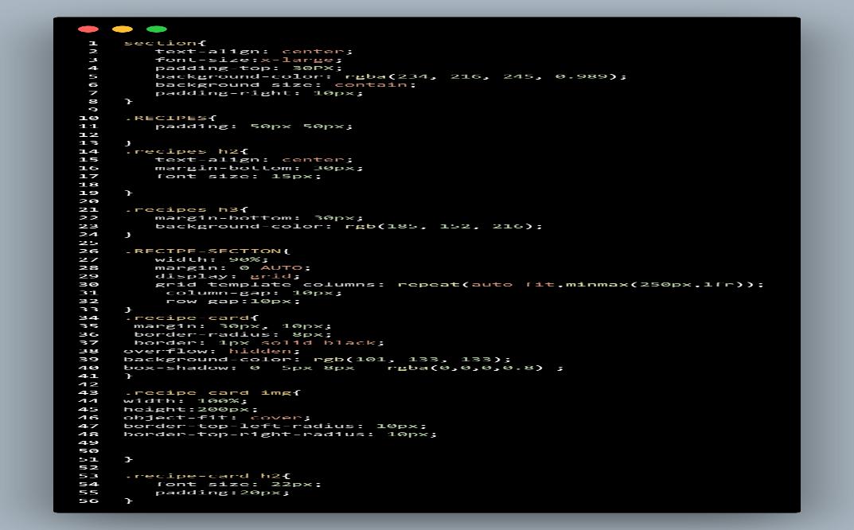
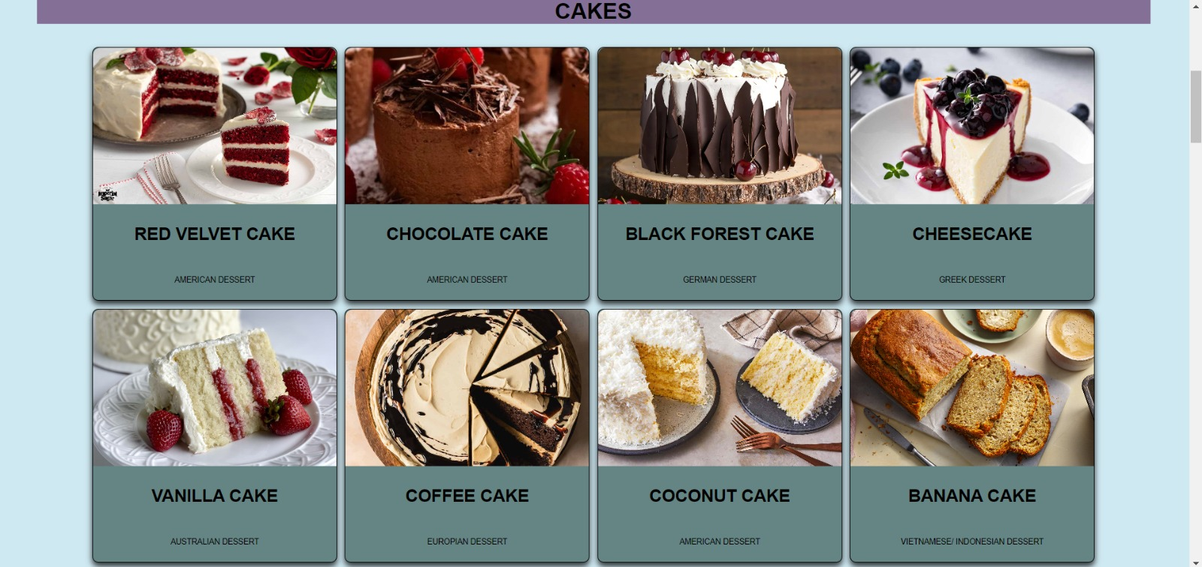
Further we divided different types of desserts as a category Like:-Cake,Shake,Cookies,Pastries
2. Second Section:- This section displays various types of cakes along with their ingredients.
(HTML) (CSS)
(OUTPUT)

Slide 9
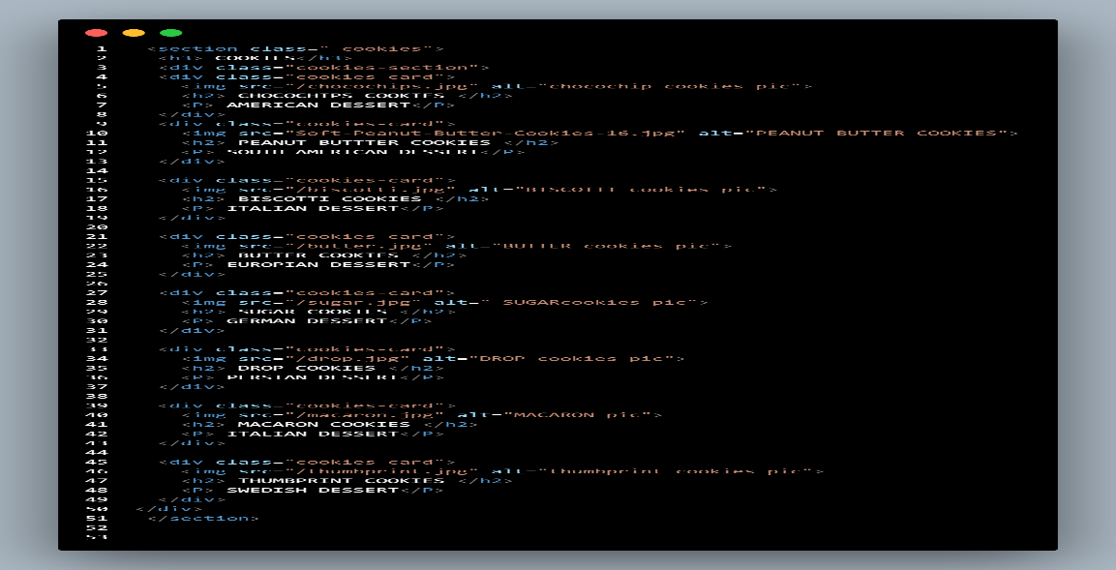
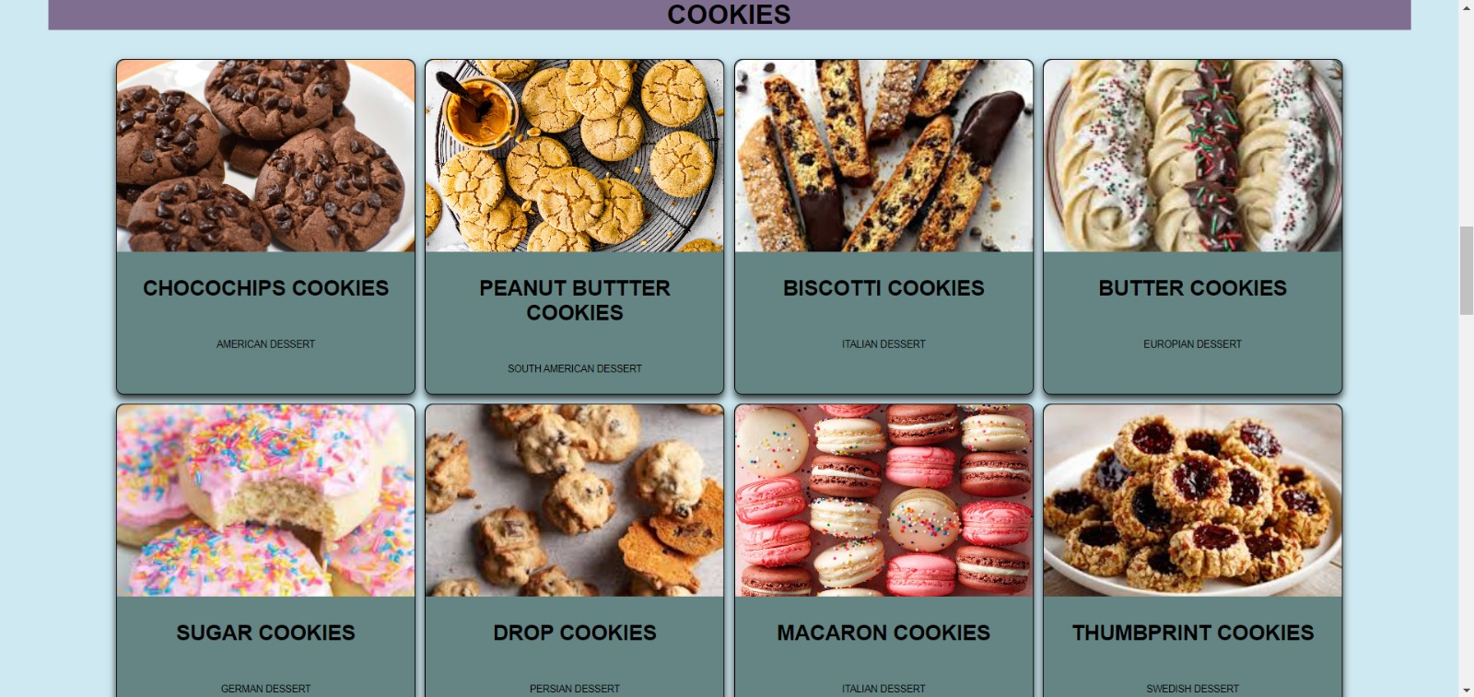
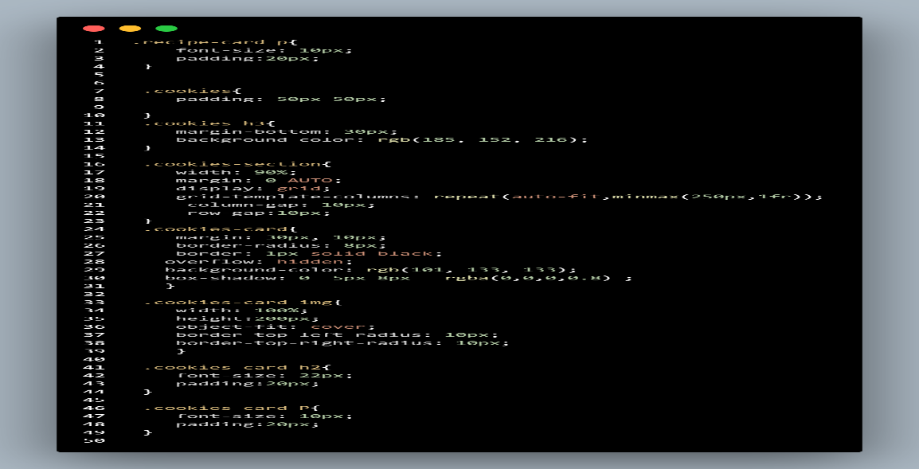
(HTML)
3.Third Section:- This section features different cookies and their corresponding ingredients.
(OUTPUT)
(CSS)

Slide 10
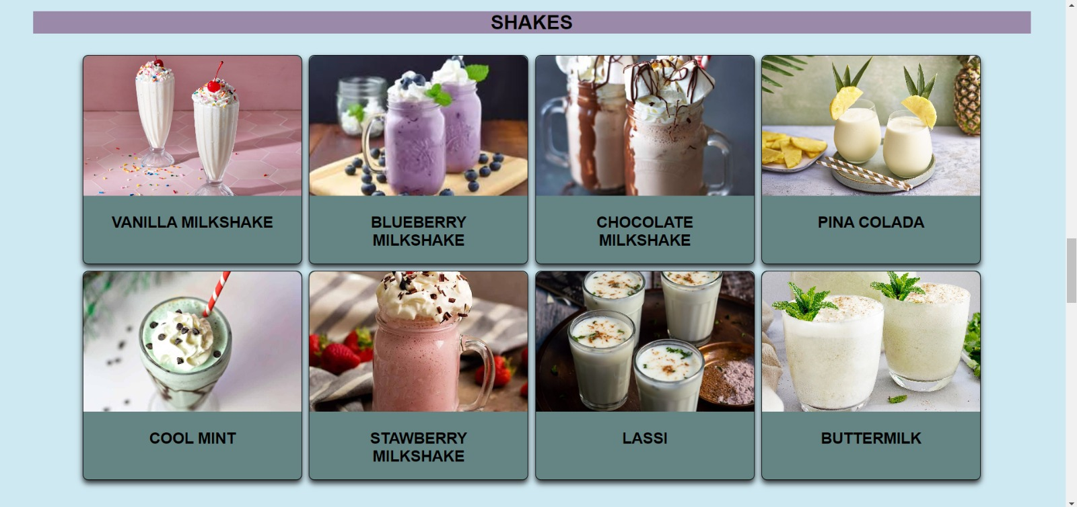
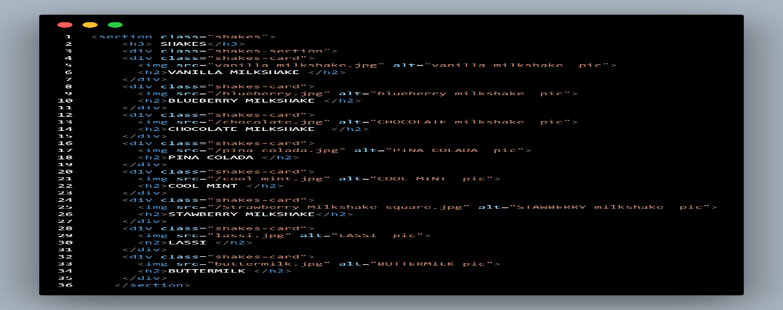
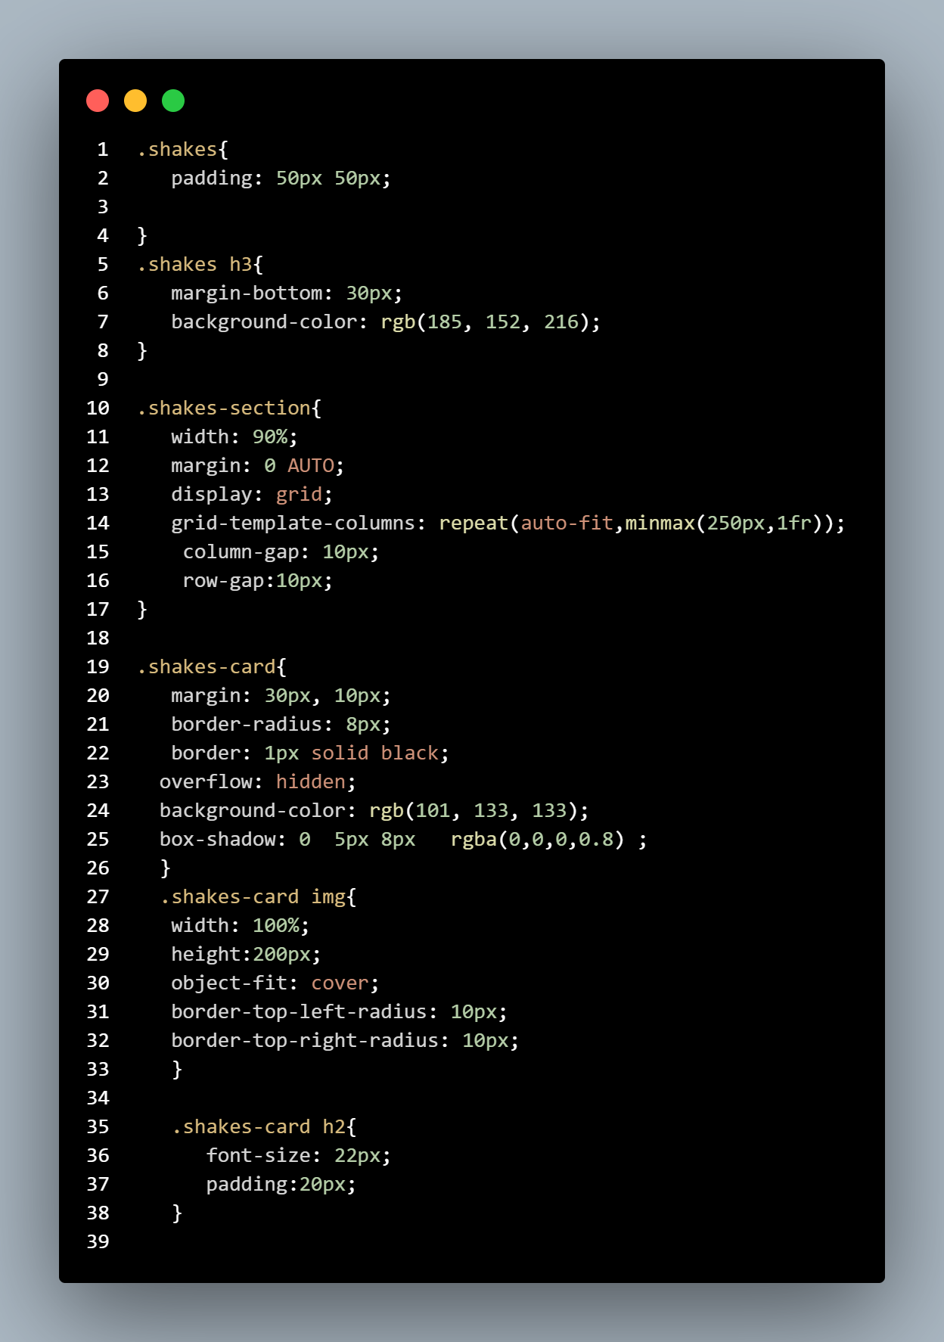
(OUTPUT)
(HTML)
(CSS)
4.Fourth Section:- This section allows users to create customized shakes and provide helpful resources.

Slide 11
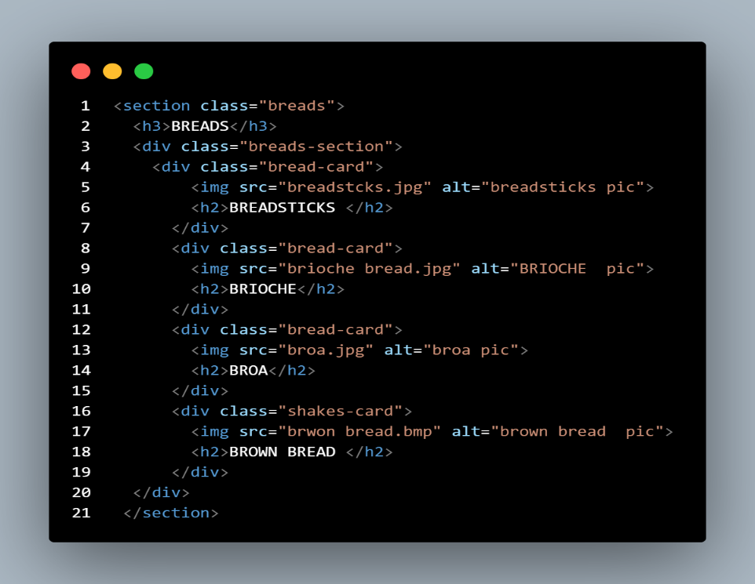
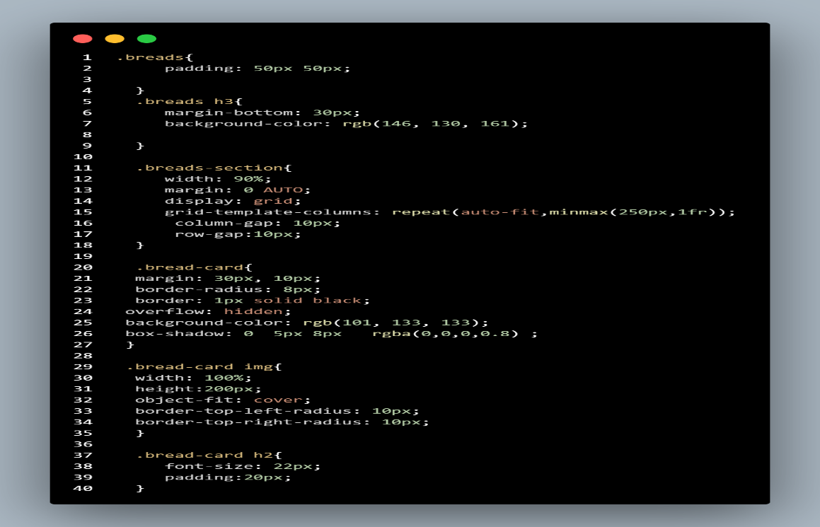
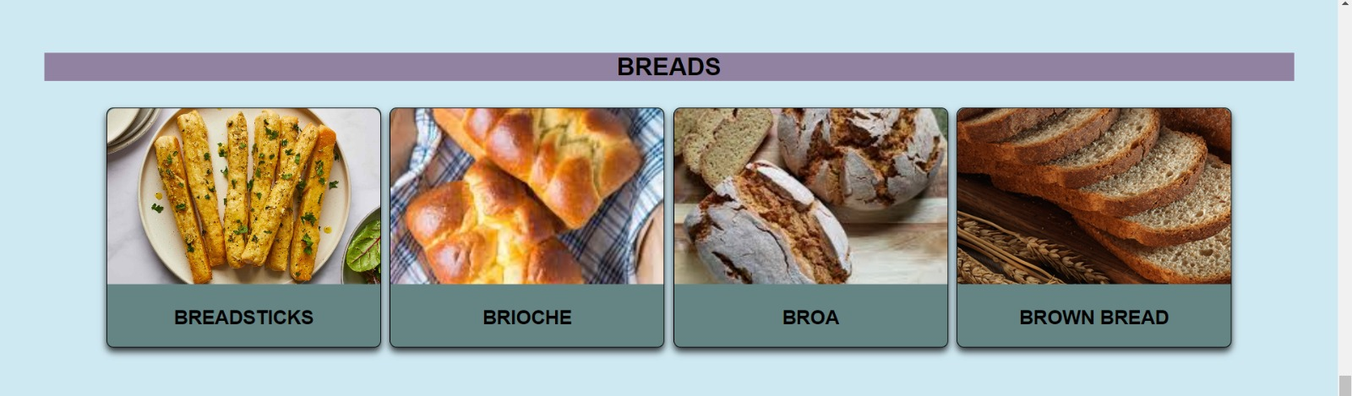
5.Fifth Section:- This section showcases a variety of enticing breads and flovers.
(HTML) (CSS)
(OUTPUT)

Slide 12
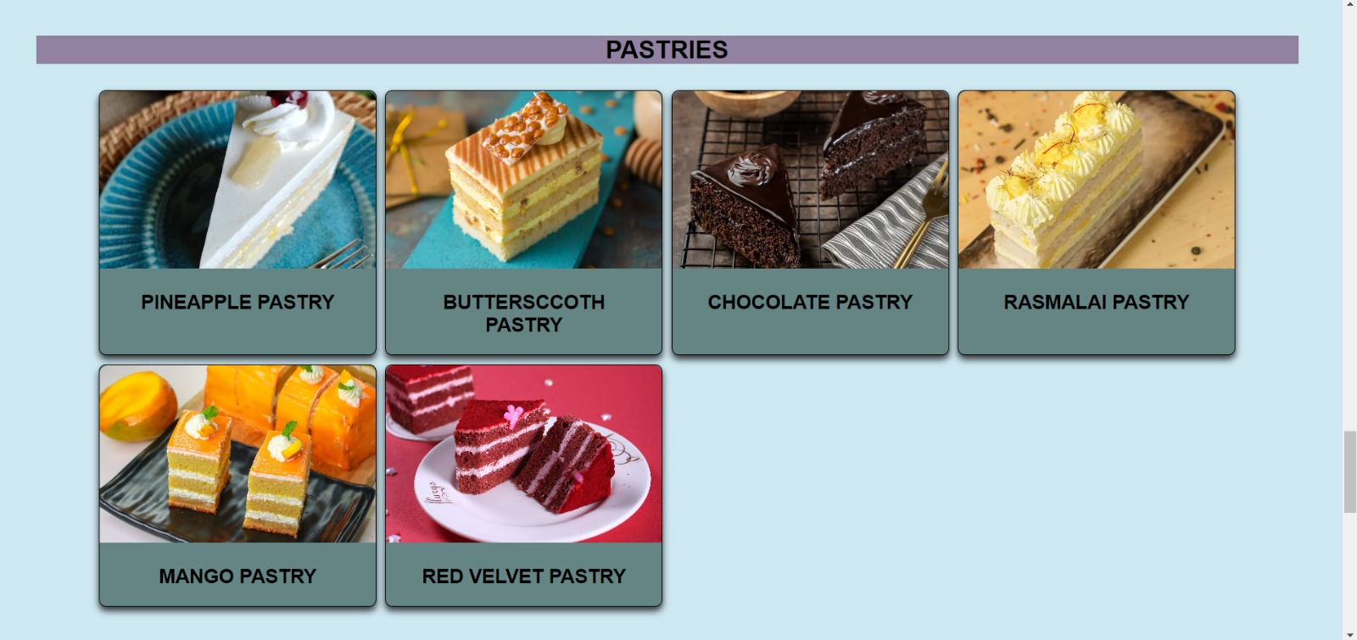
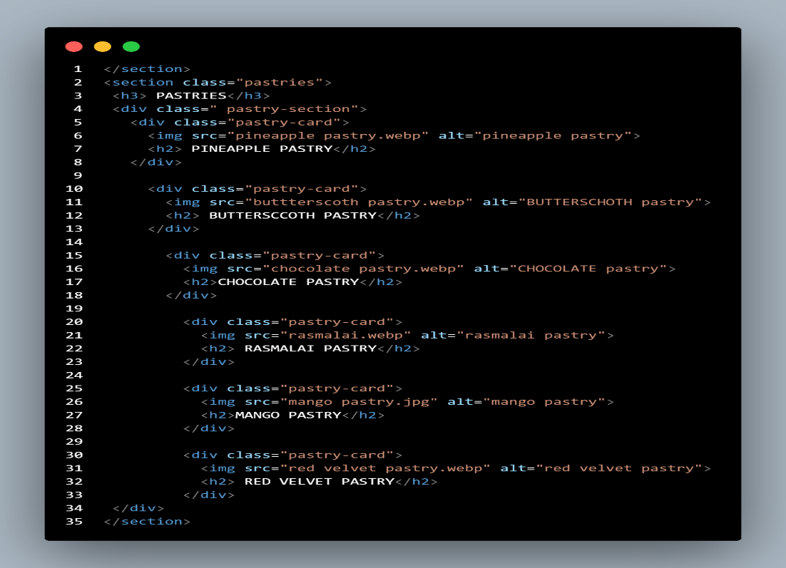
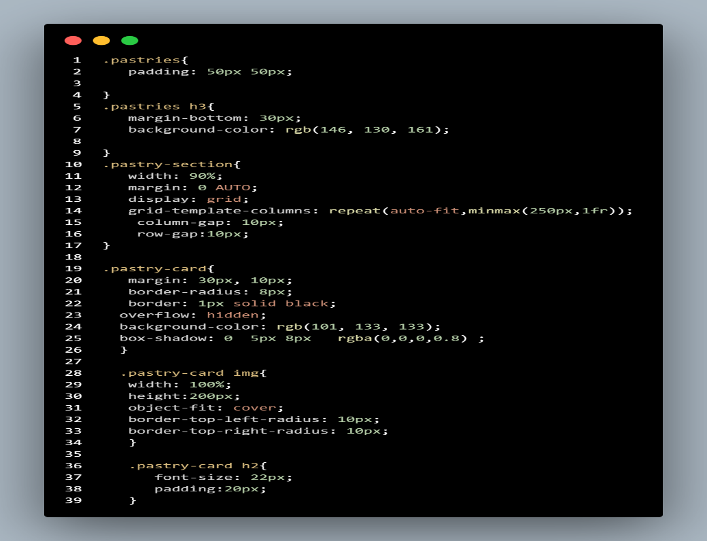
6. Sixth Section :- This section features an assortment of delightful pastries and flavours along with ingredients .
(OUTPUT)
(HTML) (CSS)

Slide 13
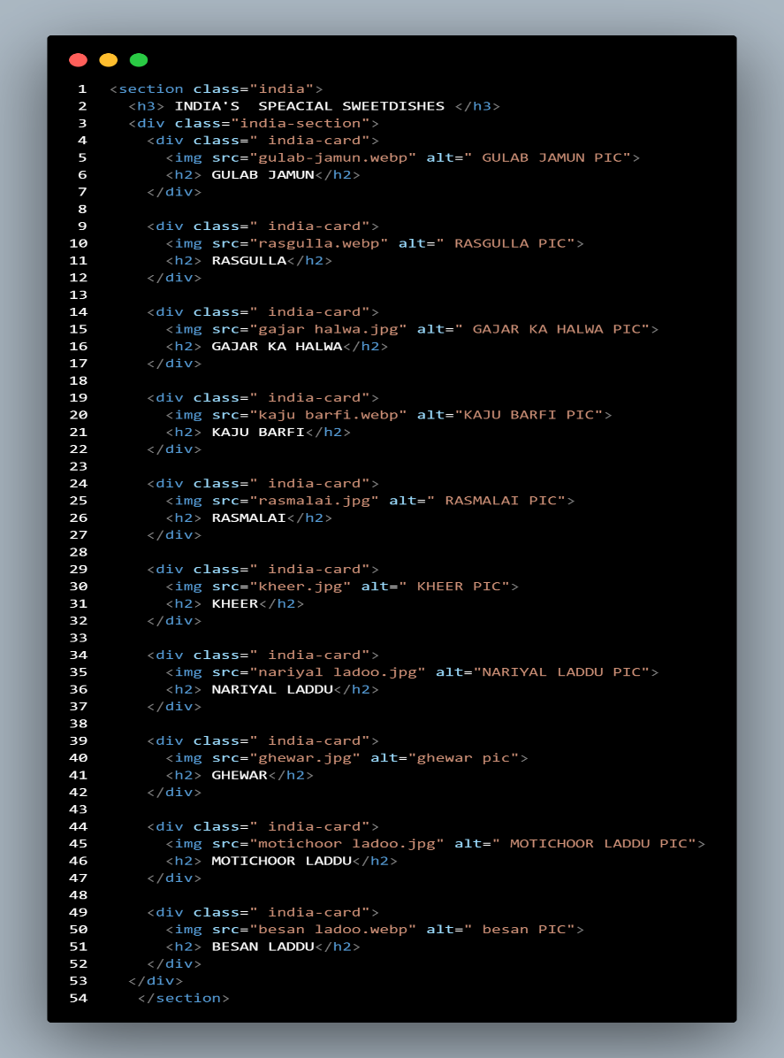
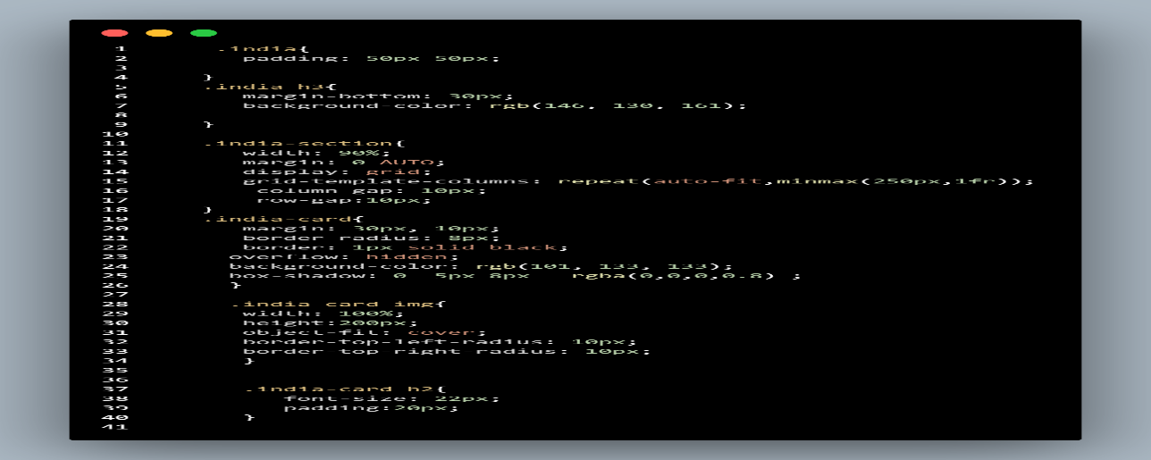
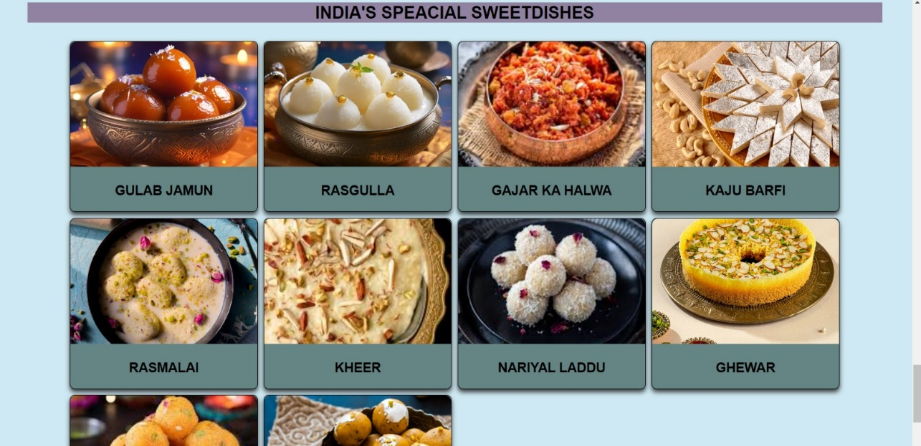
7. Seventh Section:- The unique section focuses exclusively on Indian sweets and their ingredients.
(HTML) (CSS)
(OUTPUT)

Slide 14
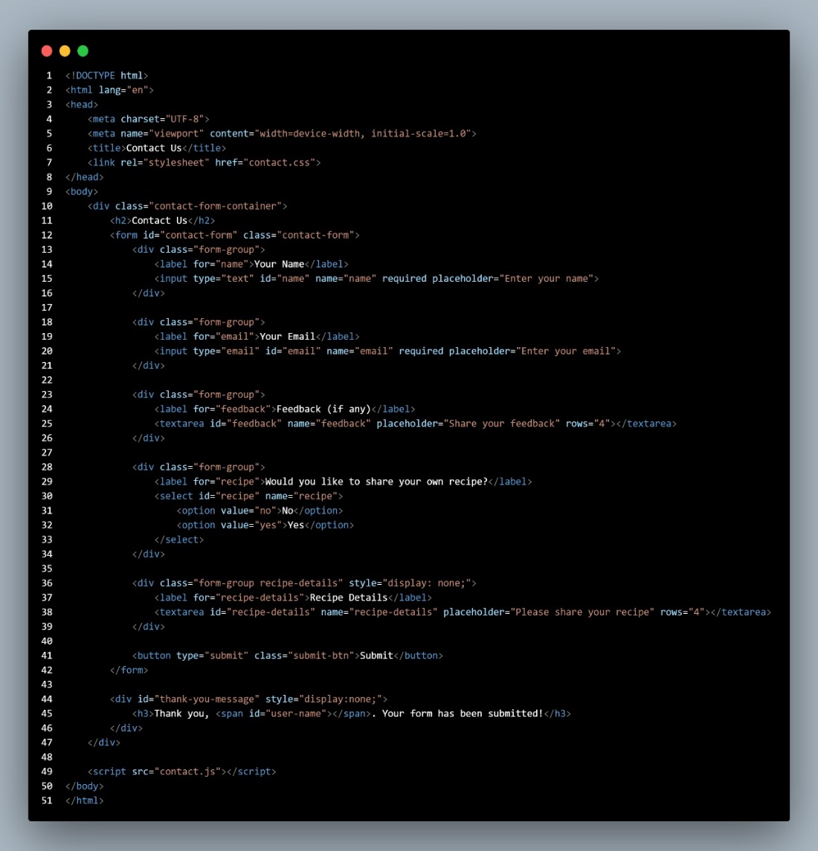
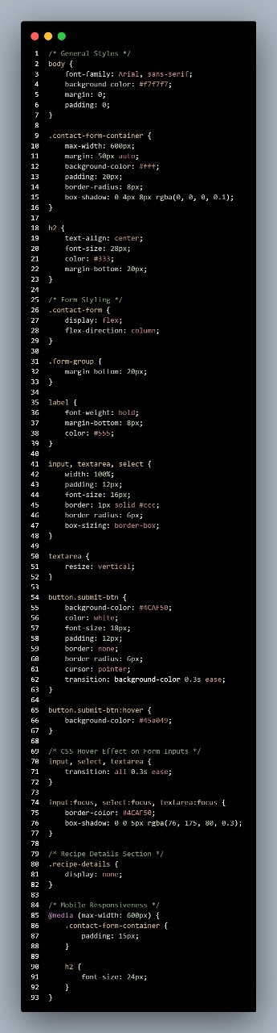
Contact us:-
The Contact Us page connects users with support and feedback options. It ensures quick and easy communication.
(HTML) (CSS)

Slide 15
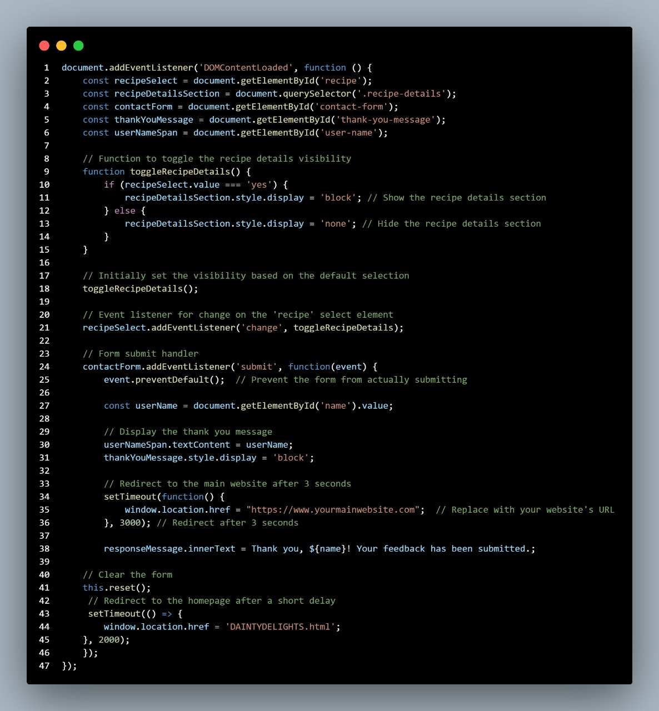
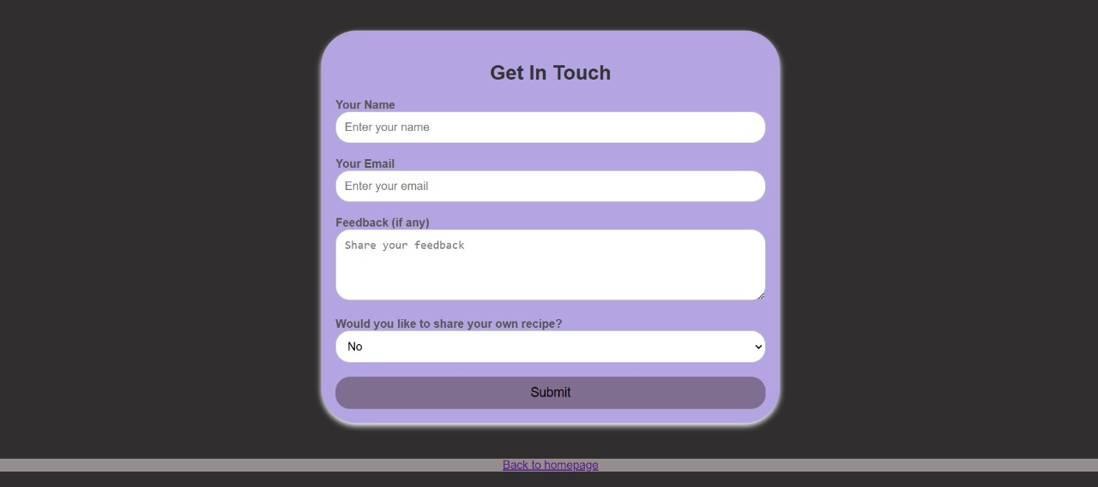
(JavaScript) (Output)

Slide 16
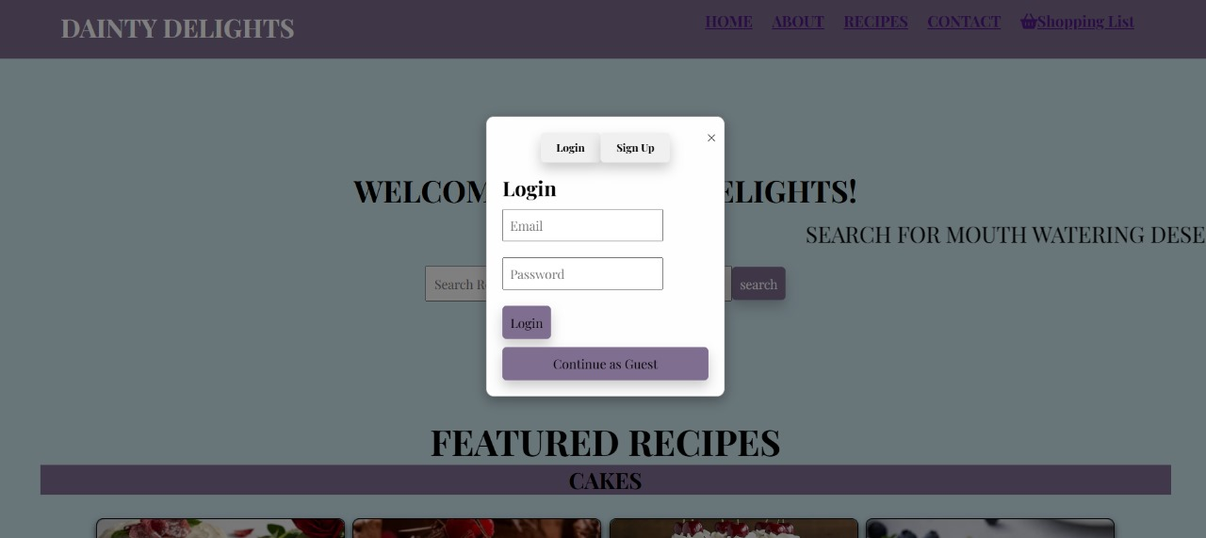
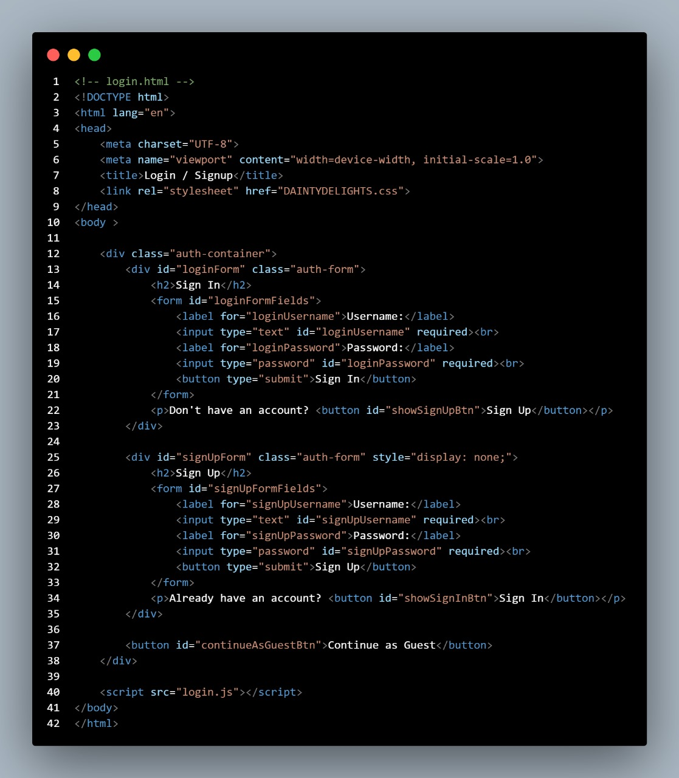
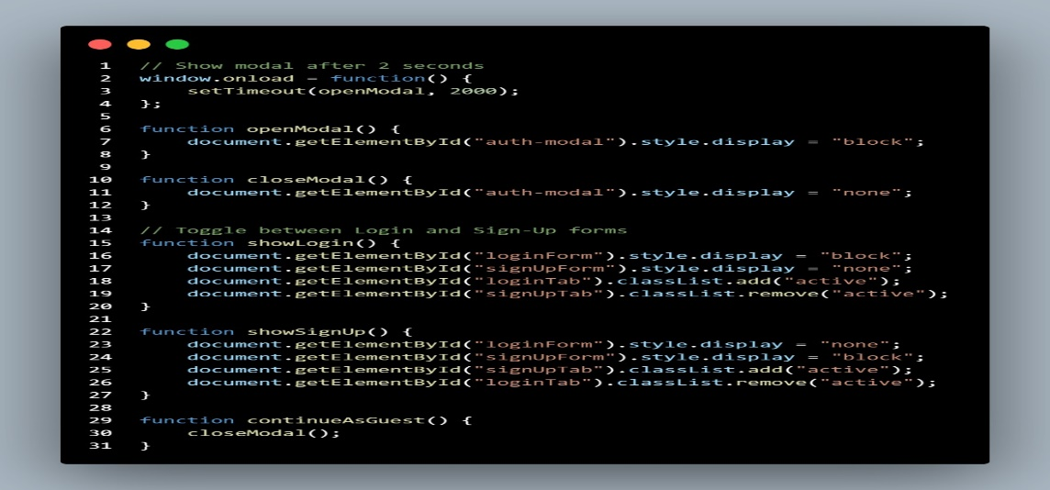
Login Page:-
The Login Page provides secure access via email login, social sign-ins, and password recovery options.
(Output)
(HTML)
(JAVASCRIPT)

Slide 17
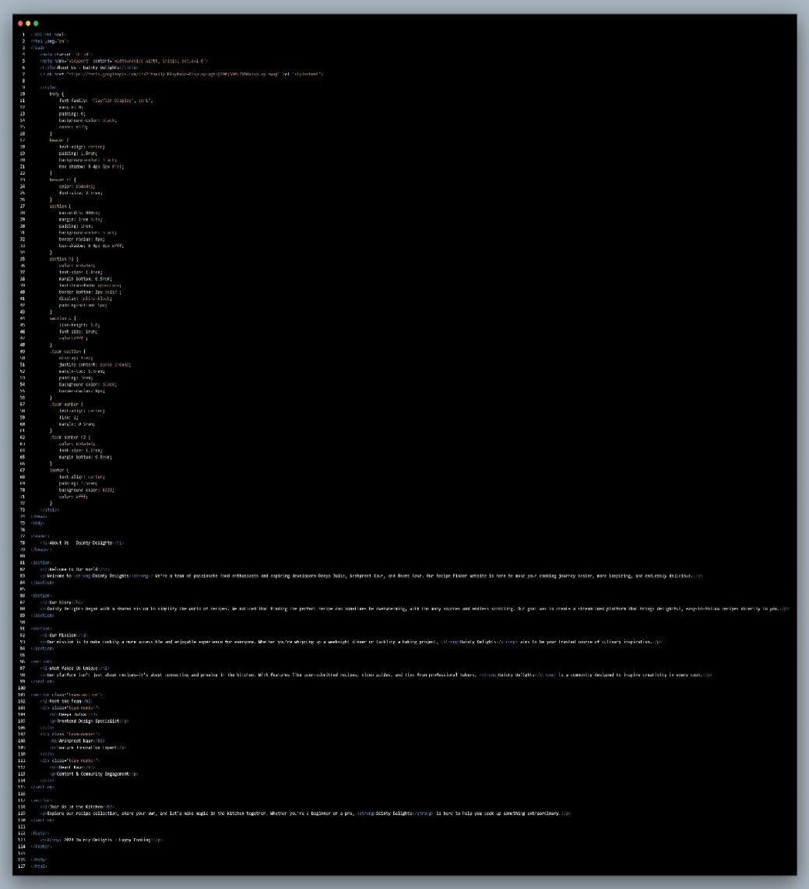
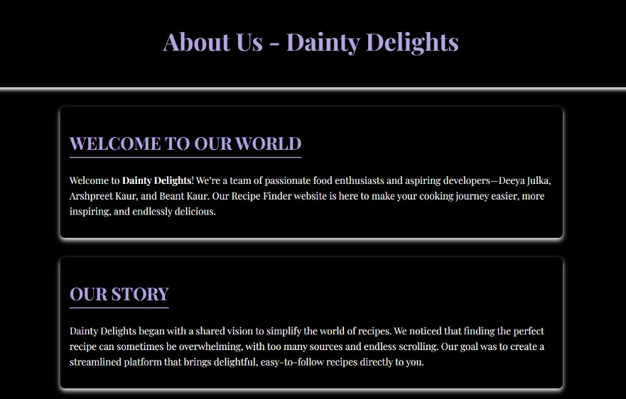
About Us:-
The About Us page provides information about Recipe Finder, its features, mission, and commitment to being a trusted platform for. discovering and saving recipes
(HTML) (OUTPUT)

Slide 18
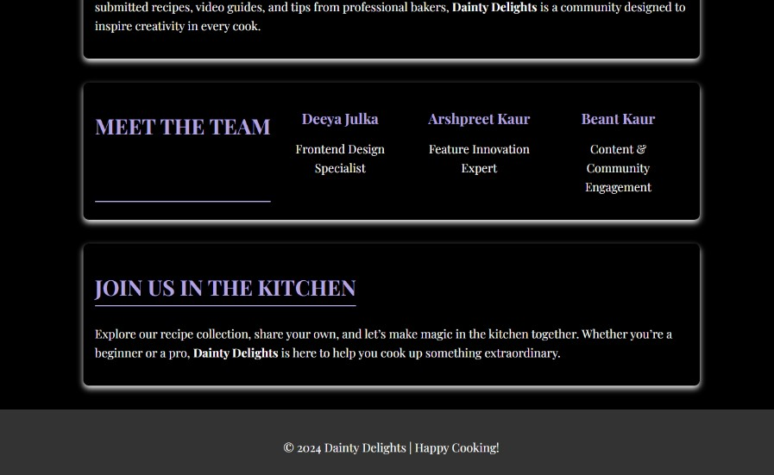
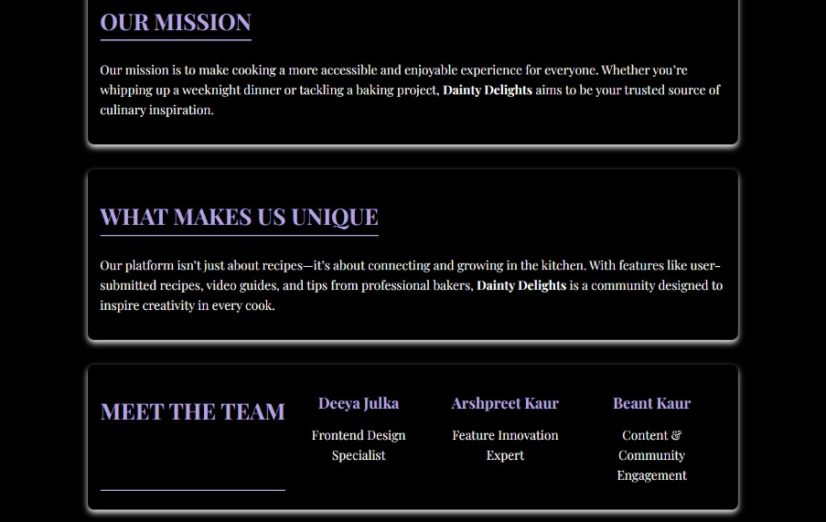
(OUTPUT)

Slide 19
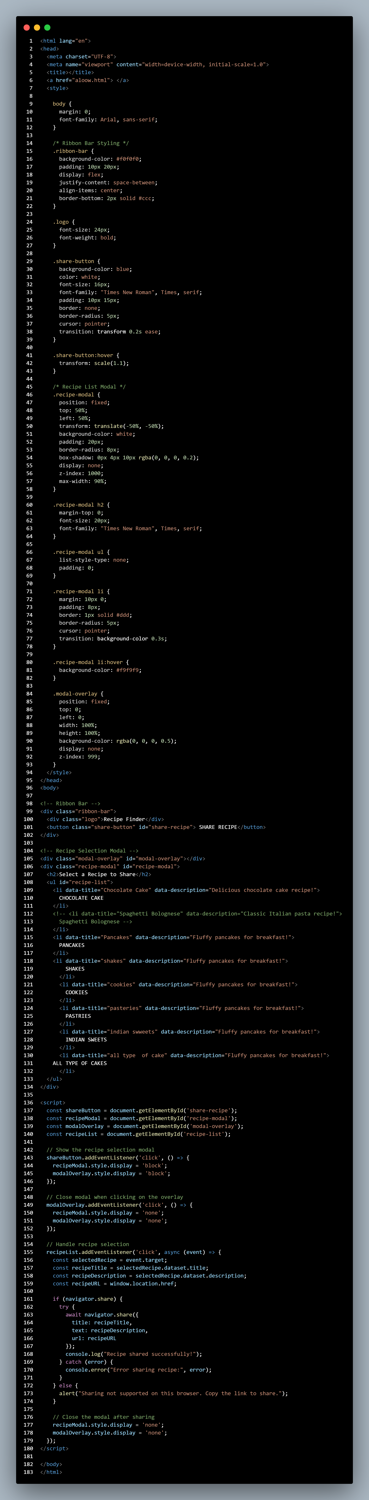
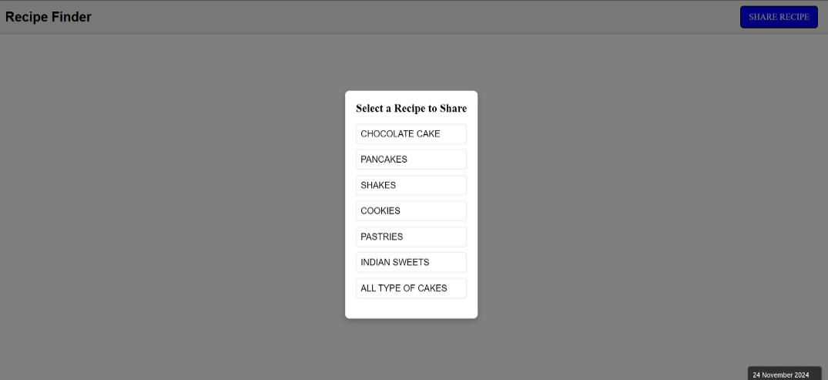
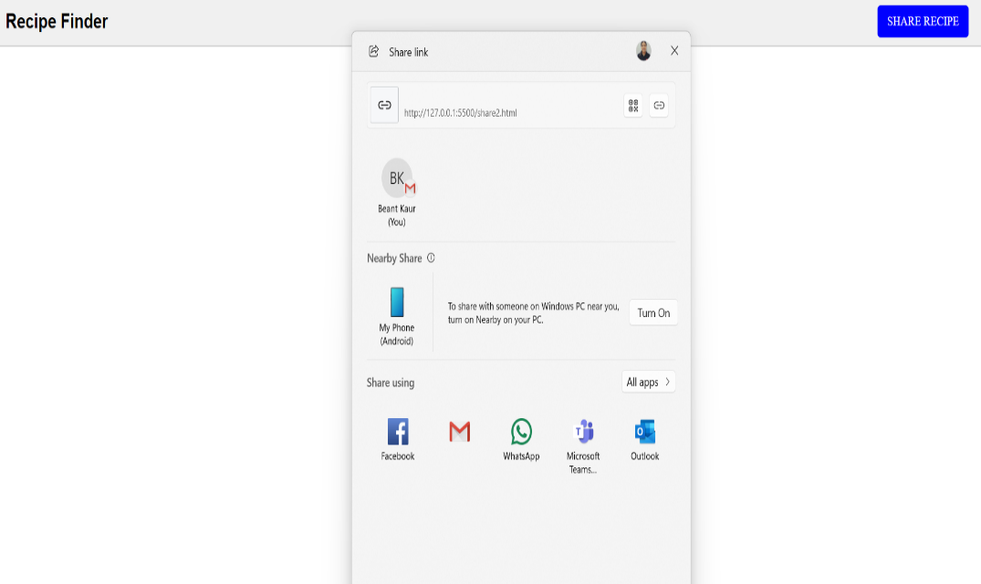
Share option:-
The Share Option empowers users to seamlessly distribute recipes across platforms such as WhatsApp and email, fostering effortless connectivity and culinary inspiration sharing.

Slide 20
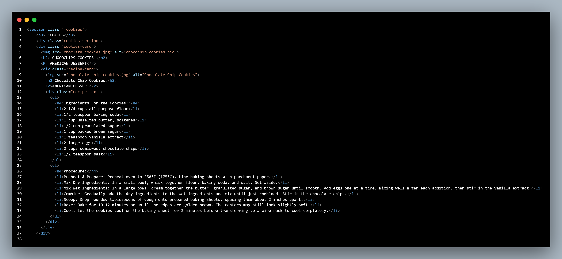
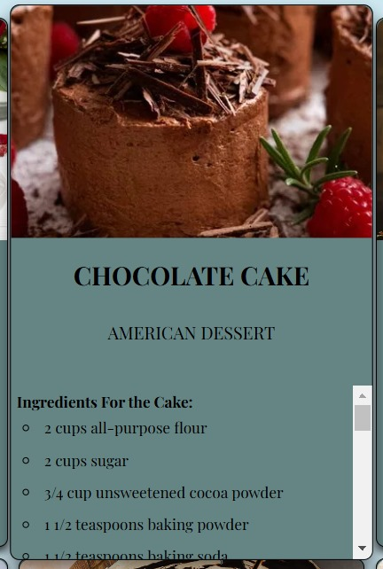
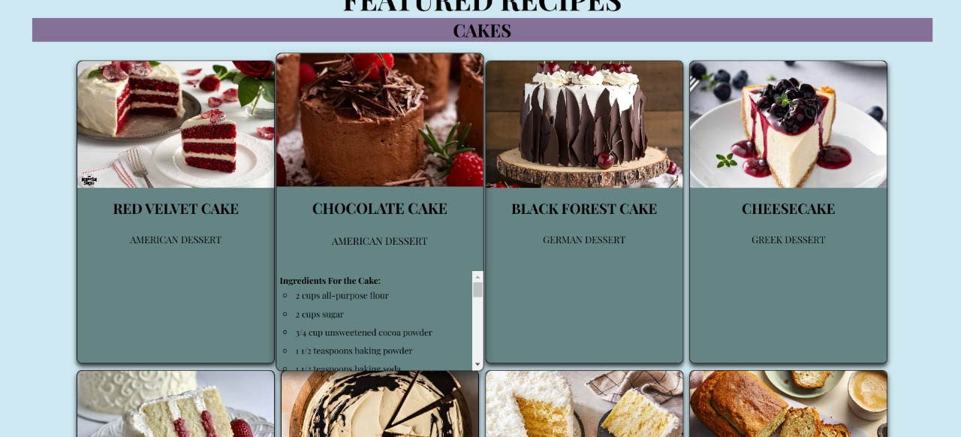
Recipes:-
The Ingredients and Procedure feature provides a clear list of ingredients and step-by-step instructions for easy cooking.

Slide 21
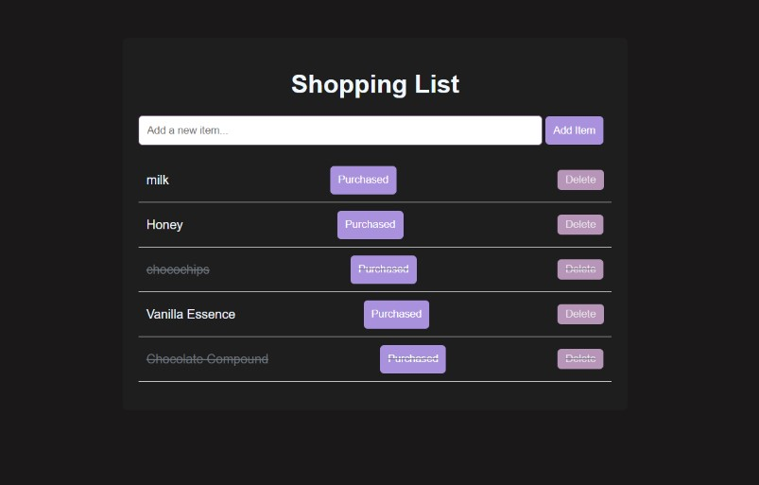
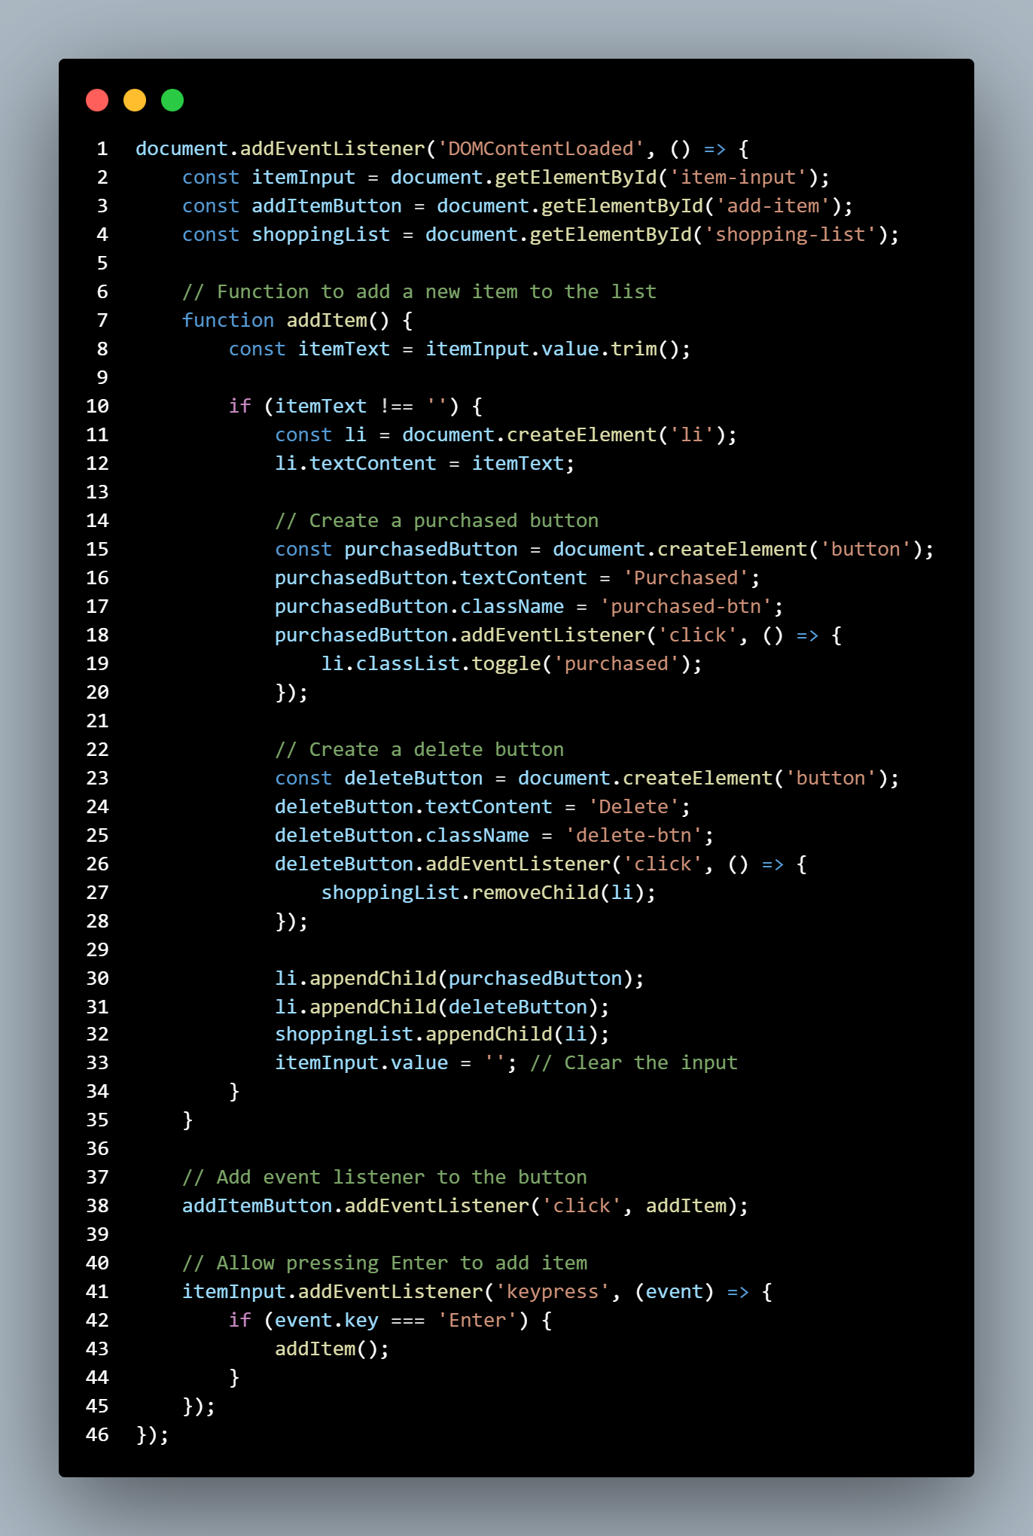
Shopping List :-
The Shopping List Generator simplifies meal preparation by creating a detailed list of ingredients required for selected recipes, ensuring users have everything they need at their fingertips.

Slide 22
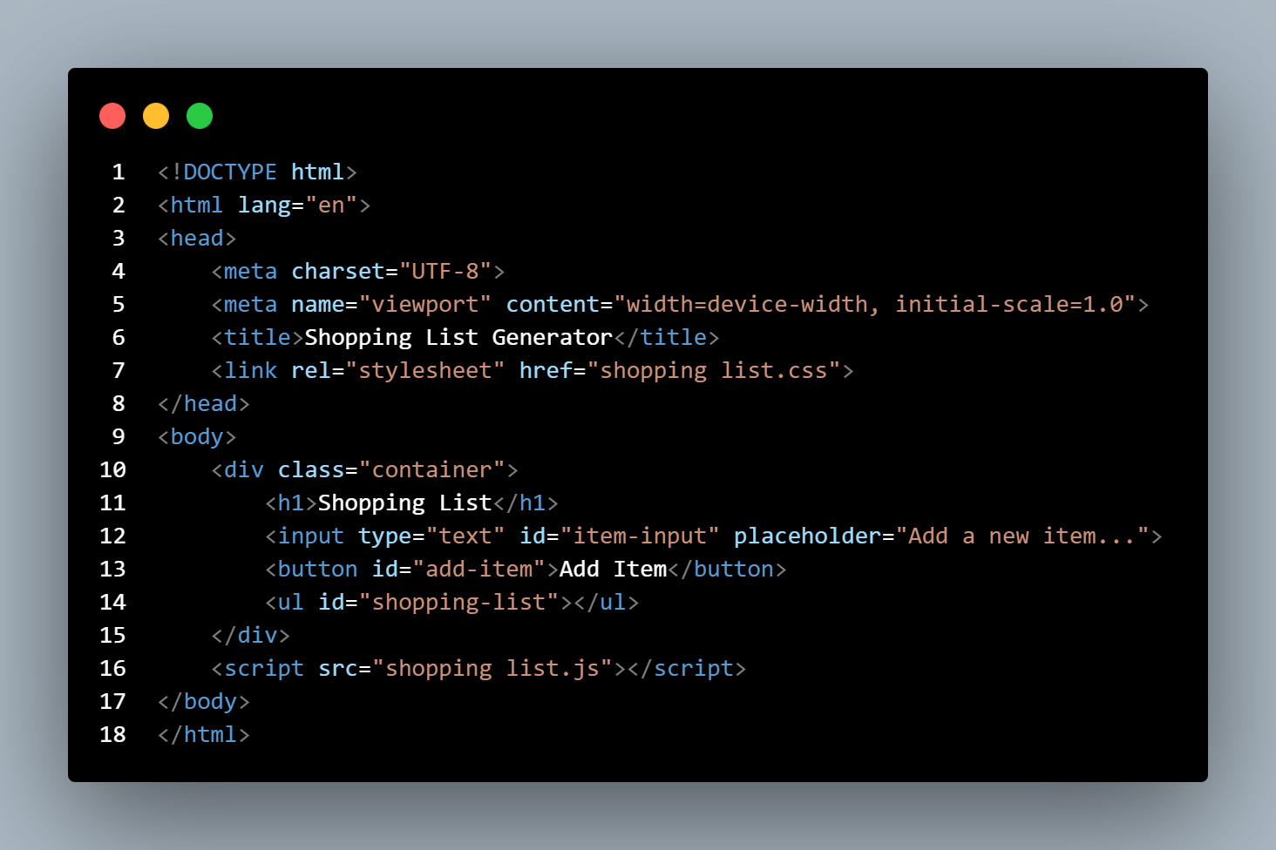
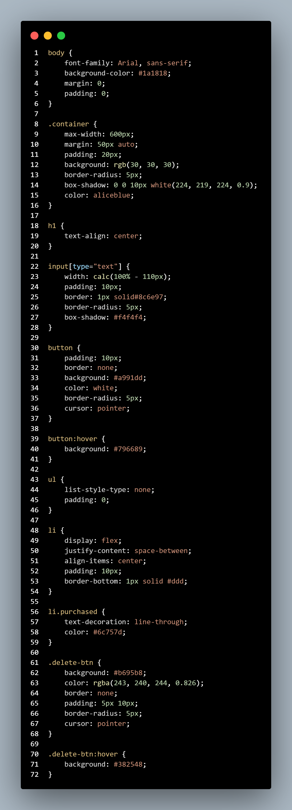
(HTML) (CSS)

Slide 23
Bonus Feature
Shopping List Generator:-User can generate their personal shopping list based on their selective recipe.
Recipe Input Option:- User can input their own recipe on site.
Save and Share Option :- User can save any of the recipe and also share recipes with their friends and family members

Slide 24
Conclusion
Project Outcome:-
The Bakery Recipe Finder app provides a specialized tool for both novice and expert bakers to explore and try new recipes based on their preferences.Helps bakers find the perfect recipe quickly, whether they’re baking cakes, cookies, breads, or pastries.
These advancements will help ensure Dainty Delights continues to be a trusted destination for home Bakers, providing both convenience and inspiration in their culinary adventures.

Slide 25
Reference: -
Helpful tutorials and guides
https://www.geeksforgeeks.org
Image sources
https://www.pexels.com
https://pixabay.com

Slide 26


